Slide 1
PowerPoint Examples Jabberwocky
Ian Justin – VP Technical Sales, GetConnect

Slide 2
Fade by line…
`Twas brillig, and the slithy toves
Did gyre and gimble in the wabe:
All mimsy were the borogoves,
And the mome raths outgrabe.

Slide 3
Fade by letter…
"Beware the Jabberwock, my son!
The jaws that bite, the claws that catch!
Beware the Jubjub bird, and shun
The frumious Bandersnatch!"

Slide 4
Dissolve by line…
He took his vorpal sword in hand:
Long time the manxome foe he sought –
So rested he by the Tumtum tree,
And stood awhile in thought.

Slide 5
Center Revolve by line…
And, as in uffish thought he stood,
The Jabberwock, with eyes of flame,
Came whiffling through the tulgey wood,
And burbled as it came!

Slide 6
Rise Up by word…
One, two! One, two! And through and through
The vorpal blade went snicker-snack!
He left it dead, and with its head
He went galumphing back.

Slide 7
Curve Up by word…
"And, has thou slain the Jabberwock?
Come to my arms, my beamish boy!
O frabjous day! Callooh! Callay!’
He chortled in his joy.

Slide 8
Flip by letter…
`Twas brillig, and the slithy toves
Did gyre and gimble in the wabe:
All mimsy were the borogoves,
And the mome raths outgrabe.

Slide 9
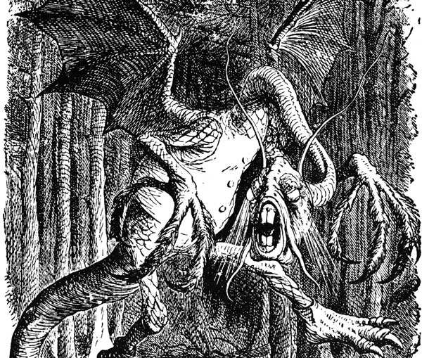
Image Transition by Fade…

Slide 10
Image Transition by Faded Zoom…

Slide 11
Image Transition by Grow & Turn…

Slide 12
Image Transition by Swivel…

Slide 13
Combined Image Transitions by Fade, Spin & Sink…

Slide 14
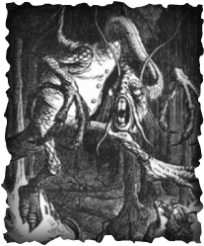
Fade, Shrink, Motion Path & Wipe…
Jabberwocky

Slide 15
Hyperlinks to Web Page, Audio & Video (from Connect Account)…
Click to see the Jabberwocky poem in full
Click to listen to Jabberwocky recited by John Hurt
Click to watch Jabberwocky by The Muppets

Slide 16
Interactive Buttons Send Formatted Email…

Slide 17
Send an Email with ‘To’, ‘Subject’ & Body Text Pre-completed…
Click to send an email as follows:
Use your default email client
To: ianjustin@getconnect.com
Subject: Test - From the PPT Examples Presentation
Body Text: Tell me more about the Jabberwocky…
Send Email to Ian Justin

Slide 18
Interactive Slide Navigation Verses…

Slide 19
Interactive Slide Navigation Verse 1…
Verse 1
Verse 2
Verse 3
Verse 4
Verse 5
Verse 6
Verse 7
`Twas brillig, and the slithy toves
Did gyre and gimble in the wabe:
All mimsy were the borogoves,
And the mome raths outgrabe.

Slide 20
Interactive Slide Navigation Verse 2…
Verse 1
Verse 2
Verse 3
Verse 4
Verse 5
Verse 6
Verse 7
"Beware the Jabberwock, my son!
The jaws that bite, the claws that catch!
Beware the Jubjub bird, and shun
The frumious Bandersnatch!"

Slide 21
Interactive Slide Navigation Verse 3…
Verse 1
Verse 2
Verse 3
Verse 4
Verse 5
Verse 6
Verse 7
He took his vorpal sword in hand:
Long time the manxome foe he sought –
So rested he by the Tumtum tree,
And stood awhile in thought..

Slide 22
Interactive Slide Navigation Verse 4…
Verse 1
Verse 2
Verse 3
Verse 4
Verse 5
Verse 6
Verse 7
And, as in uffish thought he stood,
The Jabberwock, with eyes of flame,
Came whiffling through the tulgey wood,
And burbled as it came!

Slide 23
Interactive Slide Navigation Verse 5…
Verse 1
Verse 2
Verse 3
Verse 4
Verse 5
Verse 6
Verse 7
One, two! One, two! And through and through
The vorpal blade went snicker-snack!
He left it dead, and with its head
He went galumphing back.

Slide 24
Interactive Slide Navigation Verse 6…
Verse 1
Verse 2
Verse 3
Verse 4
Verse 5
Verse 6
Verse 7
"And, has thou slain the Jabberwock?
Come to my arms, my beamish boy!
O frabjous day! Callooh! Callay!’
He chortled in his joy.

Slide 25
Interactive Slide Navigation Verse 7…
Verse 1
Verse 2
Verse 3
Verse 4
Verse 5
Verse 6
Verse 7
`Twas brillig, and the slithy toves
Did gyre and gimble in the wabe:
All mimsy were the borogoves,
And the mome raths outgrabe.

Slide 26
Interactive Slide Navigation Quiz & Exploration…

Slide 27
Quiz Example… Click on the question to see the answer
Who wrote Jabberwocky?
What book contains Jabberwocky ?
What is the meaning of the word ‘Brillig’?
When was Jabberwocky published?
Quiz
Home

Slide 28
Quiz Example… Who wrote Jabberwocky?
Lewis Carroll
What book contains Jabberwocky ?
What is the meaning of the word ‘Brillig’?
When was Jabberwocky published?
Quiz
Home

Slide 29
Quiz Example… What book contains Jabberwocky ?
Who wrote Jabberwocky?
Through the Looking-Glass and What Alice Found There
What is the meaning of the word ‘Brillig’?
When was Jabberwocky published?
Quiz
Home

Slide 30
Quiz Example… What is the meaning of the word ‘Brillig’?
Who wrote Jabberwocky?
What book contains Jabberwocky ?
Brillig' means four o'clock in the afternoon, the time when you begin broiling things for dinner
When was Jabberwocky published?
Quiz
Home

Slide 31
Quiz Example… When was Jabberwocky published?
Who wrote Jabberwocky?
What book contains Jabberwocky ?
What is the meaning of the word ‘Brillig’?
1871
Quiz
Home

Slide 32
Interactive Image Navigation Point & Learn…

Slide 33
Interactive Image… Picture Home

Slide 34
Interactive Image… The Tulgey Wood
The Tulgey Wood
The Tulgey Wood
Picture
Home

Slide 35
Interactive Image… The Claws That Catch
The Claws That Catch
Picture
Home
The Claws That Catch

Slide 36
Interactive Image… The Jaws That Bite
The Jaws That Bite
Picture
Home

Slide 37
Interactive Image… The Manxome Foe
The Manxome Foe
Picture
Home

